Slide 1
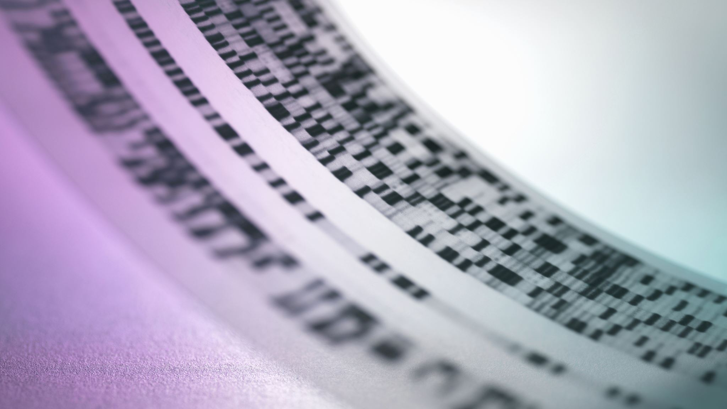
LNI Reference Checker
Automated Academic Reference Verification
Module 12 Individual Project – Information Technology

Slide 2
Motivation & Problem
Professors spend hours manually checking student references
Common issues in submissions:
Missing bibliography entries
Incorrect LNI key formats
Fabricated / fake references
Retracted papers cited
Formatting errors (page ranges, author order)
Need for fast, automated, multi-source verification

Slide 3
Solution Overview
LNI Reference Checker – Web-based tool for faculty & reviewers
Upload PDF, DOCX, or LaTeX (+ optional .bib)
Three‑tab comprehensive report:
📚 Bibliography – format completeness & issues
🔀 Cross‑Check – citations vs. bibliography entries
🔬 Verification – real / fake / retracted detection
AI‑powered fake reference detection
Parallel API queries (9 free academic databases)
Professor review queue & venue whitelist
Batch mode for multiple papers

Slide 4
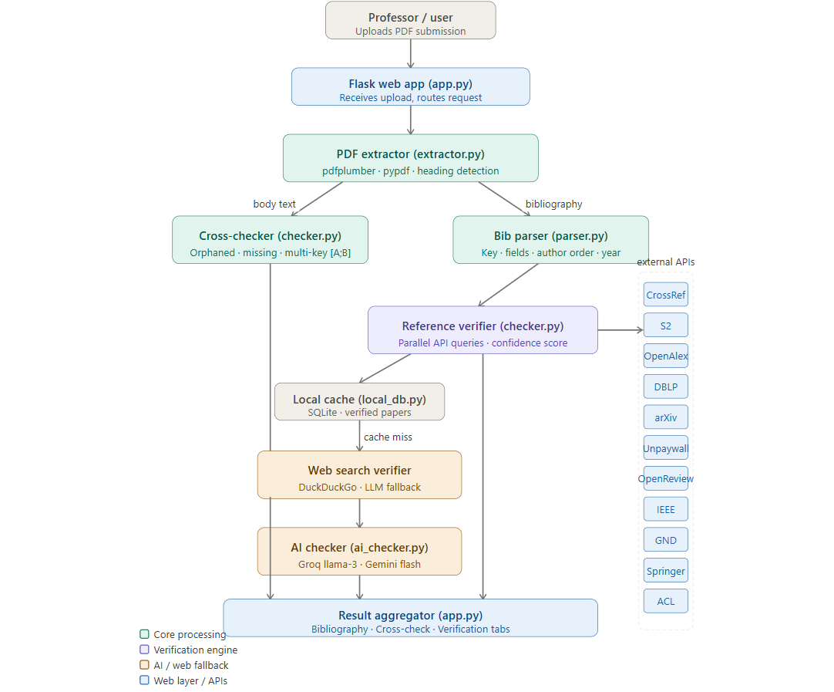
System Architecture

Slide 5
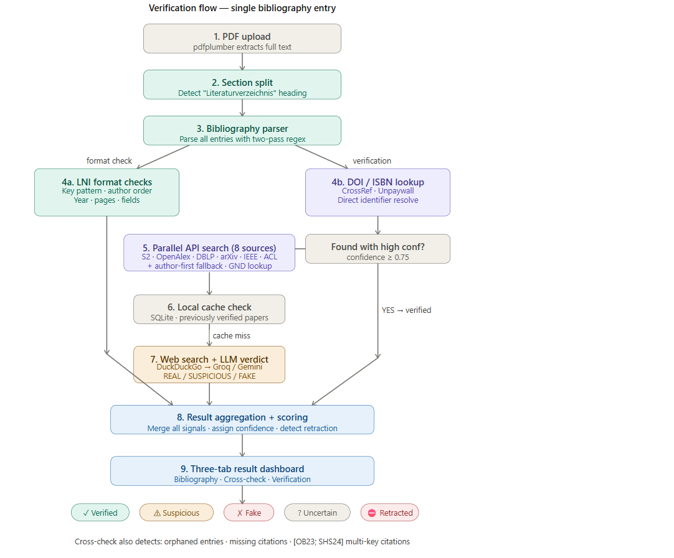
Reference Verification Pipeline

Slide 6
Scoring System (0–100)
Grade scale: A+ (95+) … F (<45)
Penalty | Per item | Cap
Retracted paper cited | –25 | 50
Missing from bibliography | –10 | 30
Likely fabricated reference | –15 | 45
Year mismatch (>1 year) | –8 | 24
Author mismatch | –5 | 20
Orphaned bib entry | –5 | 20
Incomplete LNI entry | –5 | 20
Duplicate entry | –5 | 10
LNI style violations | –2 | 6

Slide 7
Key Features
Multi‑format support (PDF, DOCX, TeX/.bib)
Scanned PDF detection & user warnings
Real‑time progress streaming (Server‑Sent Events)
Batch mode – upload up to 50 files
AI‑powered fake reference identification
Retraction checking via CrossRef
Export corrected .bib with database metadata
Professor review queue & false‑positive correction
Dark mode & responsive UI
Comprehensive test suite (110+ tests)

Slide 8
Test Coverage
Category P (50 tests) – LNI key validation, parser, completeness
Category C (38 tests) – title similarity, surname extraction, author overlap
Category E (22 tests) – bibliography detection, PDF/DOCX extraction
Category D (12 tests) – SQLite cache, normalisation
Category I (10 tests) – real API integration (network)
Category S (15 tests) – edge cases, performance
Category X (10 tests) – cross‑check logic
Run: pytest tests/test_all.py -v

Slide 9
Demo – Using the Tool
Start
Start server: python app.py
Open
Open browser → http://localhost:5000
Upload
Upload a student submission (PDF/DOCX/TeX)
Toggle
Toggle Verify references online (recommended)
Click
Click Run Check → watch live progress
Explore
Explore three tabs:
Bibliography – formatting errors
Cross‑Check – missing/orphaned citations
Verification – real/fake/retracted per reference
Export
Export corrected BibTeX or print report
Select
For batch: select multiple files → Run Batch

Slide 10
Technical Stack
Backend: Flask (Python 3.10+)
Frontend: HTML5/CSS3/JavaScript (vanilla)
Document extraction: pdfplumber, pypdf, python‑docx
APIs (all free): CrossRef, Semantic Scholar, OpenAlex, DBLP, ACL, IEEE, CORE, Springer, Unpaywall
AI: Groq (LLaMA 3.3 70B) + Gemini 1.5 Flash fallback
Web search: DuckDuckGo (ddgs)
Caching: SQLite + disk cache
Testing: pytest, reportlab (fixtures)
Deployment: Gunicorn, environment variables

Slide 11
Challenges & Solutions
Challenge | Solution
Scanned / image‑only PDFs | Warning banner + fallback extraction; recommend original source
Slow API rate limits | Parallel threads, in‑memory + disk cache, rate limiting
German conferences not in global databases | Whitelist (review_queue.py) for GI/LNI/Dagstuhl venues
AI false positives | Composite scoring + professor manual override + false‑positive table

Slide 12
Future Improvements
Integration with LMS (Moodle/Canvas) for automated grading
Support for more document formats (ODT, RTF)
Fine‑tuned local LLM for offline fake detection
User dashboard with historical submissions
Plagiarism detection integration
Interactive BibTeX editor for students
REST API for third‑party tools

Slide 13
References & Acknowledgements
LNI Style Guide – Gesellschaft für Informatik e.V.
RefChecker – inspiration for LLM‑based verification
CrossRef, Semantic Scholar, OpenAlex, DBLP – free APIs
Groq (LLaMA) and Google Gemini – free AI tiers
Fonts: IBM Plex Sans & Mono
Icons: standard Unicode
Project repository: (provided separately)

Slide 14
Thank You / Q&A
Thank You
Questions?

